Slide 1
State of the Pandemic
Dr. Walensky

Slide 2
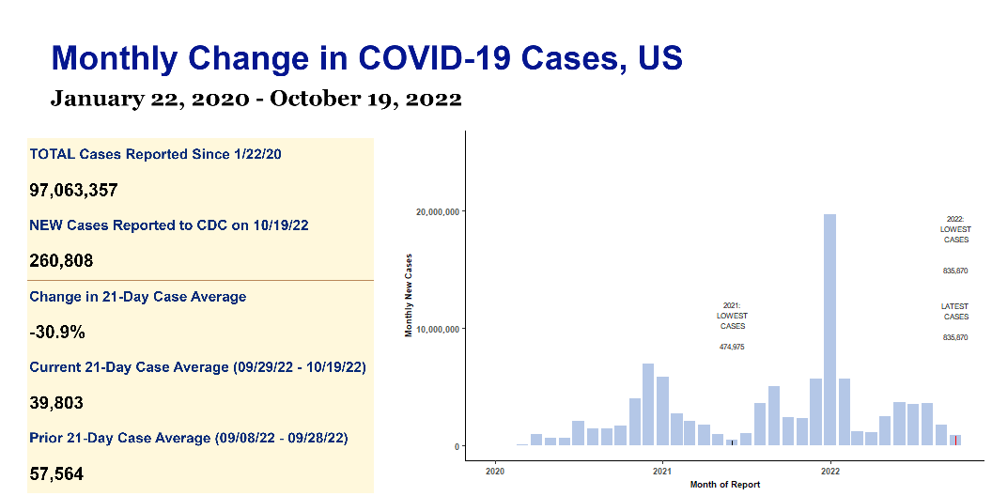

Slide 3
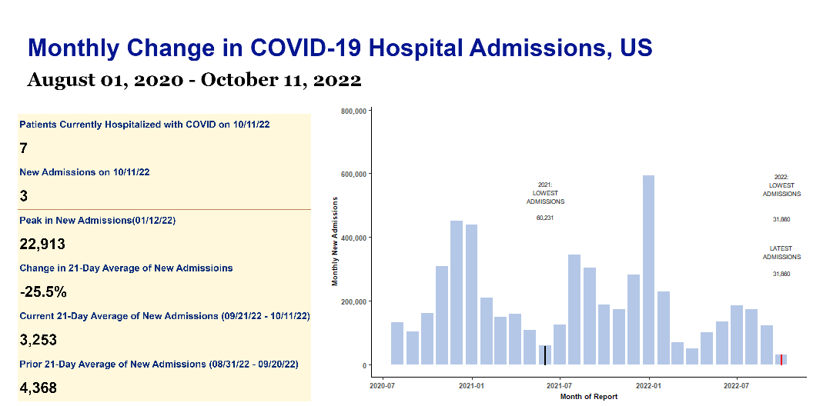

Slide 4
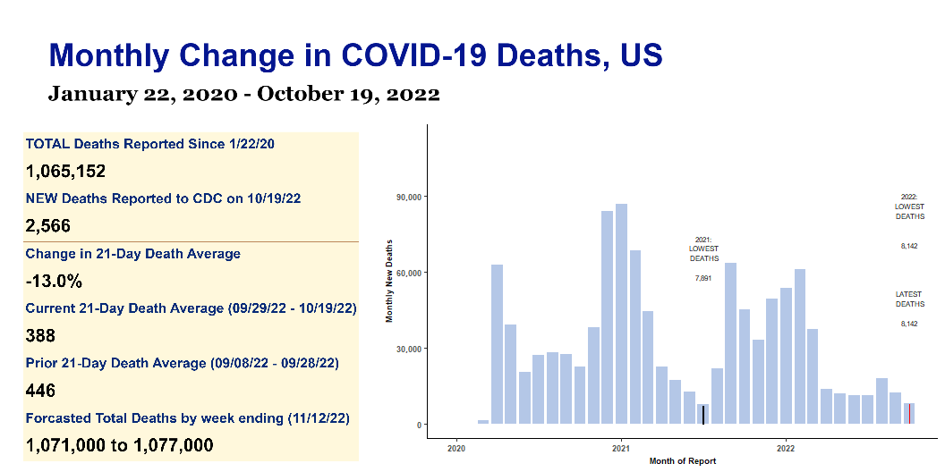

Slide 5
US Monthly COVID Report | US Monthly COVID Report | US Monthly COVID Report | US Monthly COVID Report | US Monthly COVID Report
s | s | s | s | s
Key Metrics | Key Metrics | Key Metrics | Key Metrics | Key Metrics
indicator | Total to date | Most recent week | Daily average | Period-on-period change
Cases | 97,063,357 | 260,808 | 39,803 | -30.9%
Hospital Admissions | 5,395,984 | 18,752 | 2,679 | -21.6%
Deaths | 1,065,152 | 2,566 | 388 | -13.0%
Test Positivity | 9.5% | N/A | 8.6% | 2.7%

